Slide 1
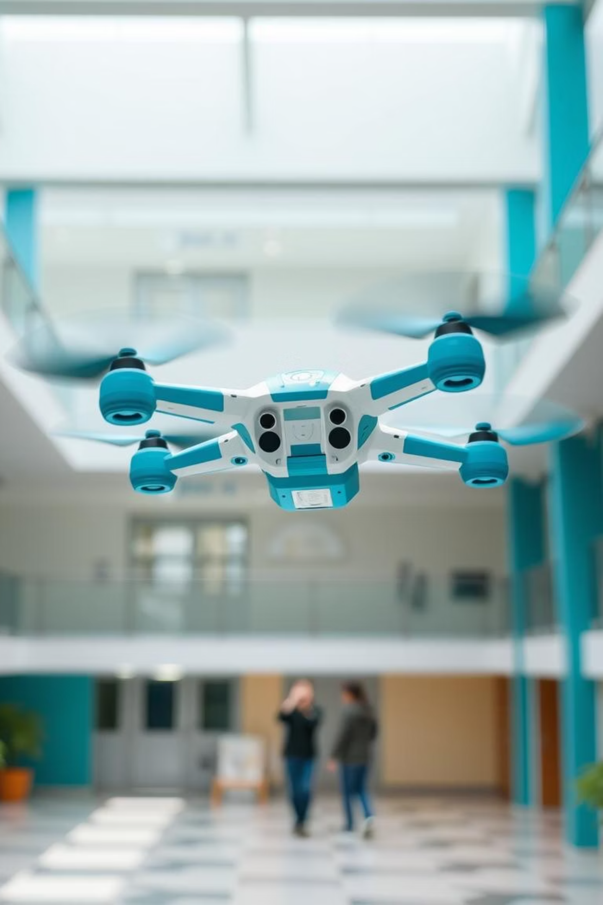
Field and Service Robotics: Technical Report
Fabio Ruggiero 2024/2025
Students:
Gianmarco Corrado P38000287
Andrea Colapinto P38000309

Slide 2
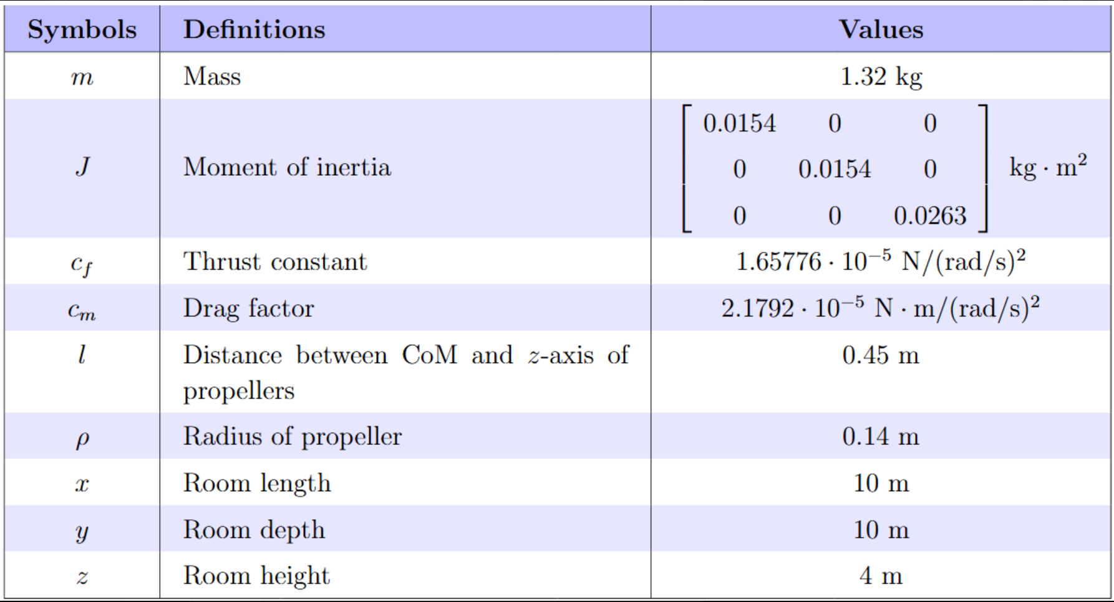
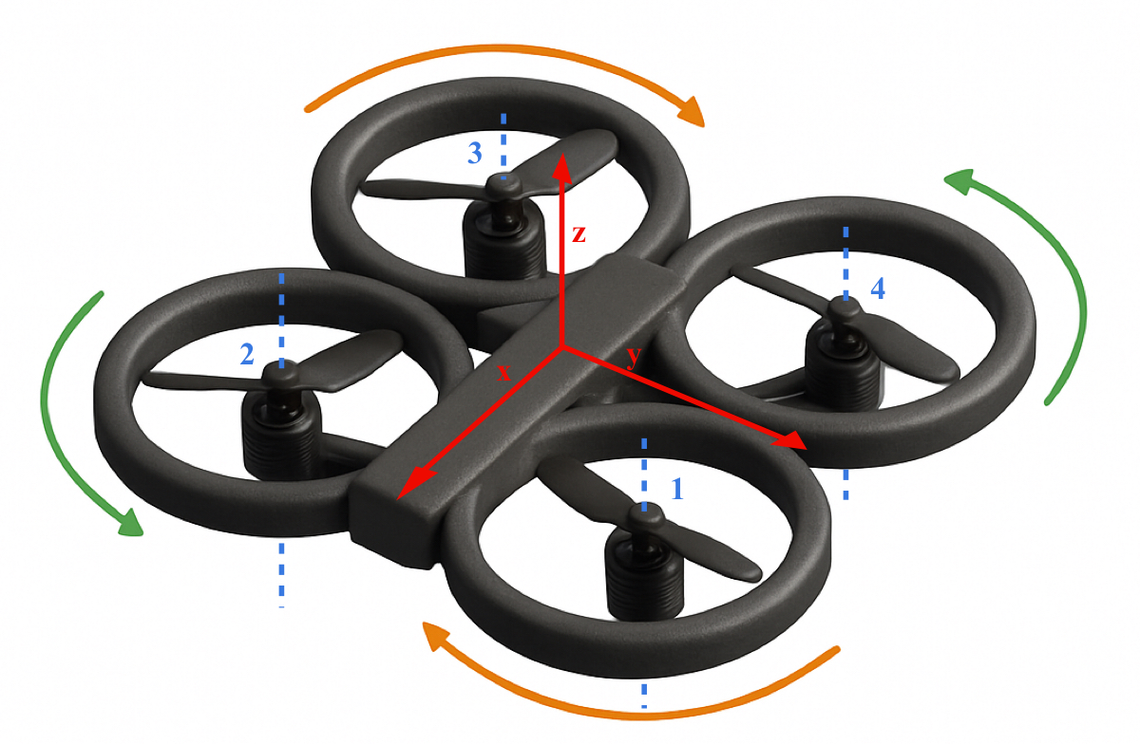
Project Overview

Slide 3




Mission Objectives & Implementation
The UAV's mission is to navigate a cluttered 3D indoor environment, pass through a narrow opening, and hover precisely at a target location.
Full Nonlinear Dynamic Model for a tilting
quadrotor
Polynomial-Based Trajectory Planning and 3D environment
UAV with tilt-rotor actuation dynamics.
Structured indoor environment and smooth path generation.
Aerodynamic Effects and Disturbances
Integration
Simulink and MATLAB-Based NMPC
Controller
Ground and ceiling interactions and robustness analysis.
Optimal control input computation with Voliro approach.

Slide 4
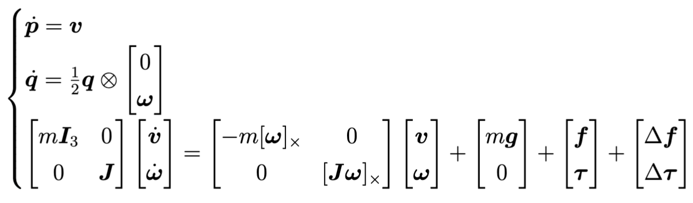
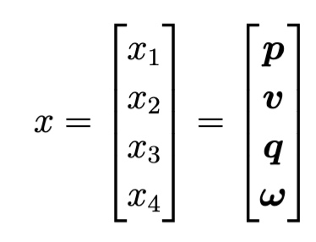
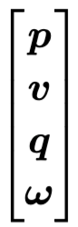
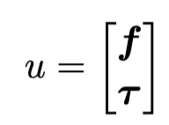
Dynamic Model
Nonlinear model consisting of 6 inputs, 13 states and 13 outputs.
Representation in ENU frame
Orientation is represented using a unit quaternion to avoid singularities and maintain a column vector format.

Slide 5
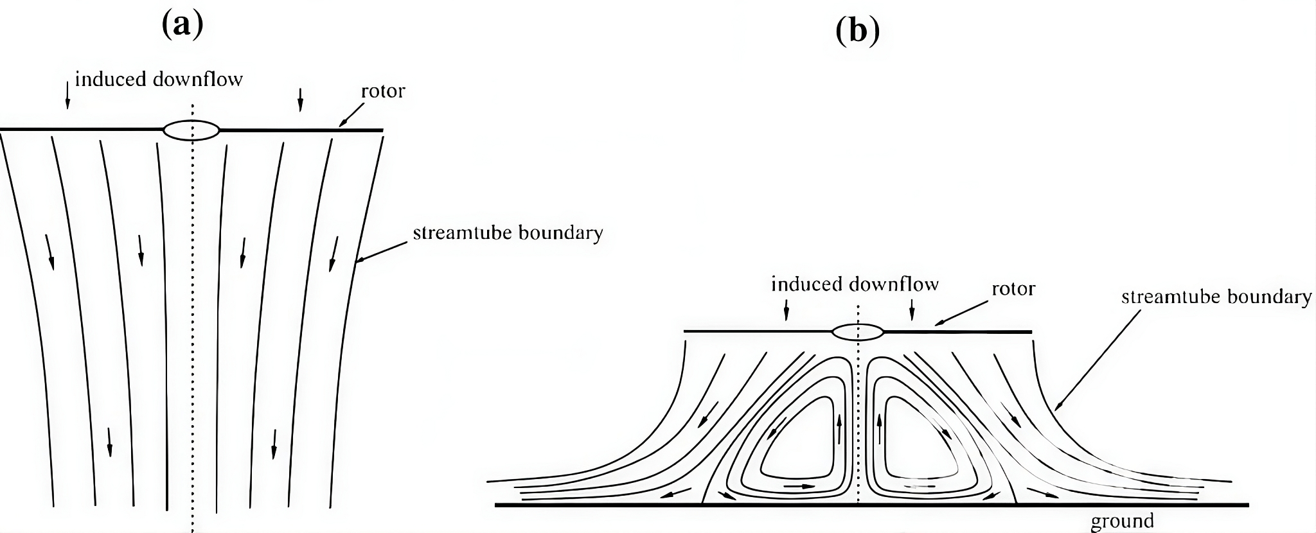
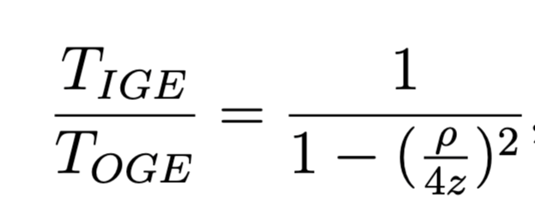
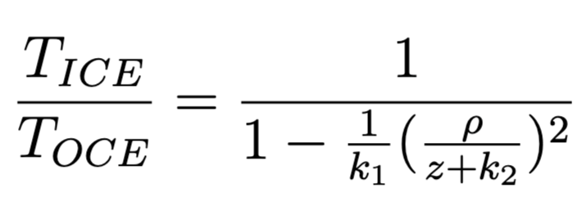
Aerodynamic Effects
Aerodynamic effects like ground and ceiling interactions significantly influence thrust efficiency near surfaces.
Ground Effect
Ceiling Effect

Slide 6
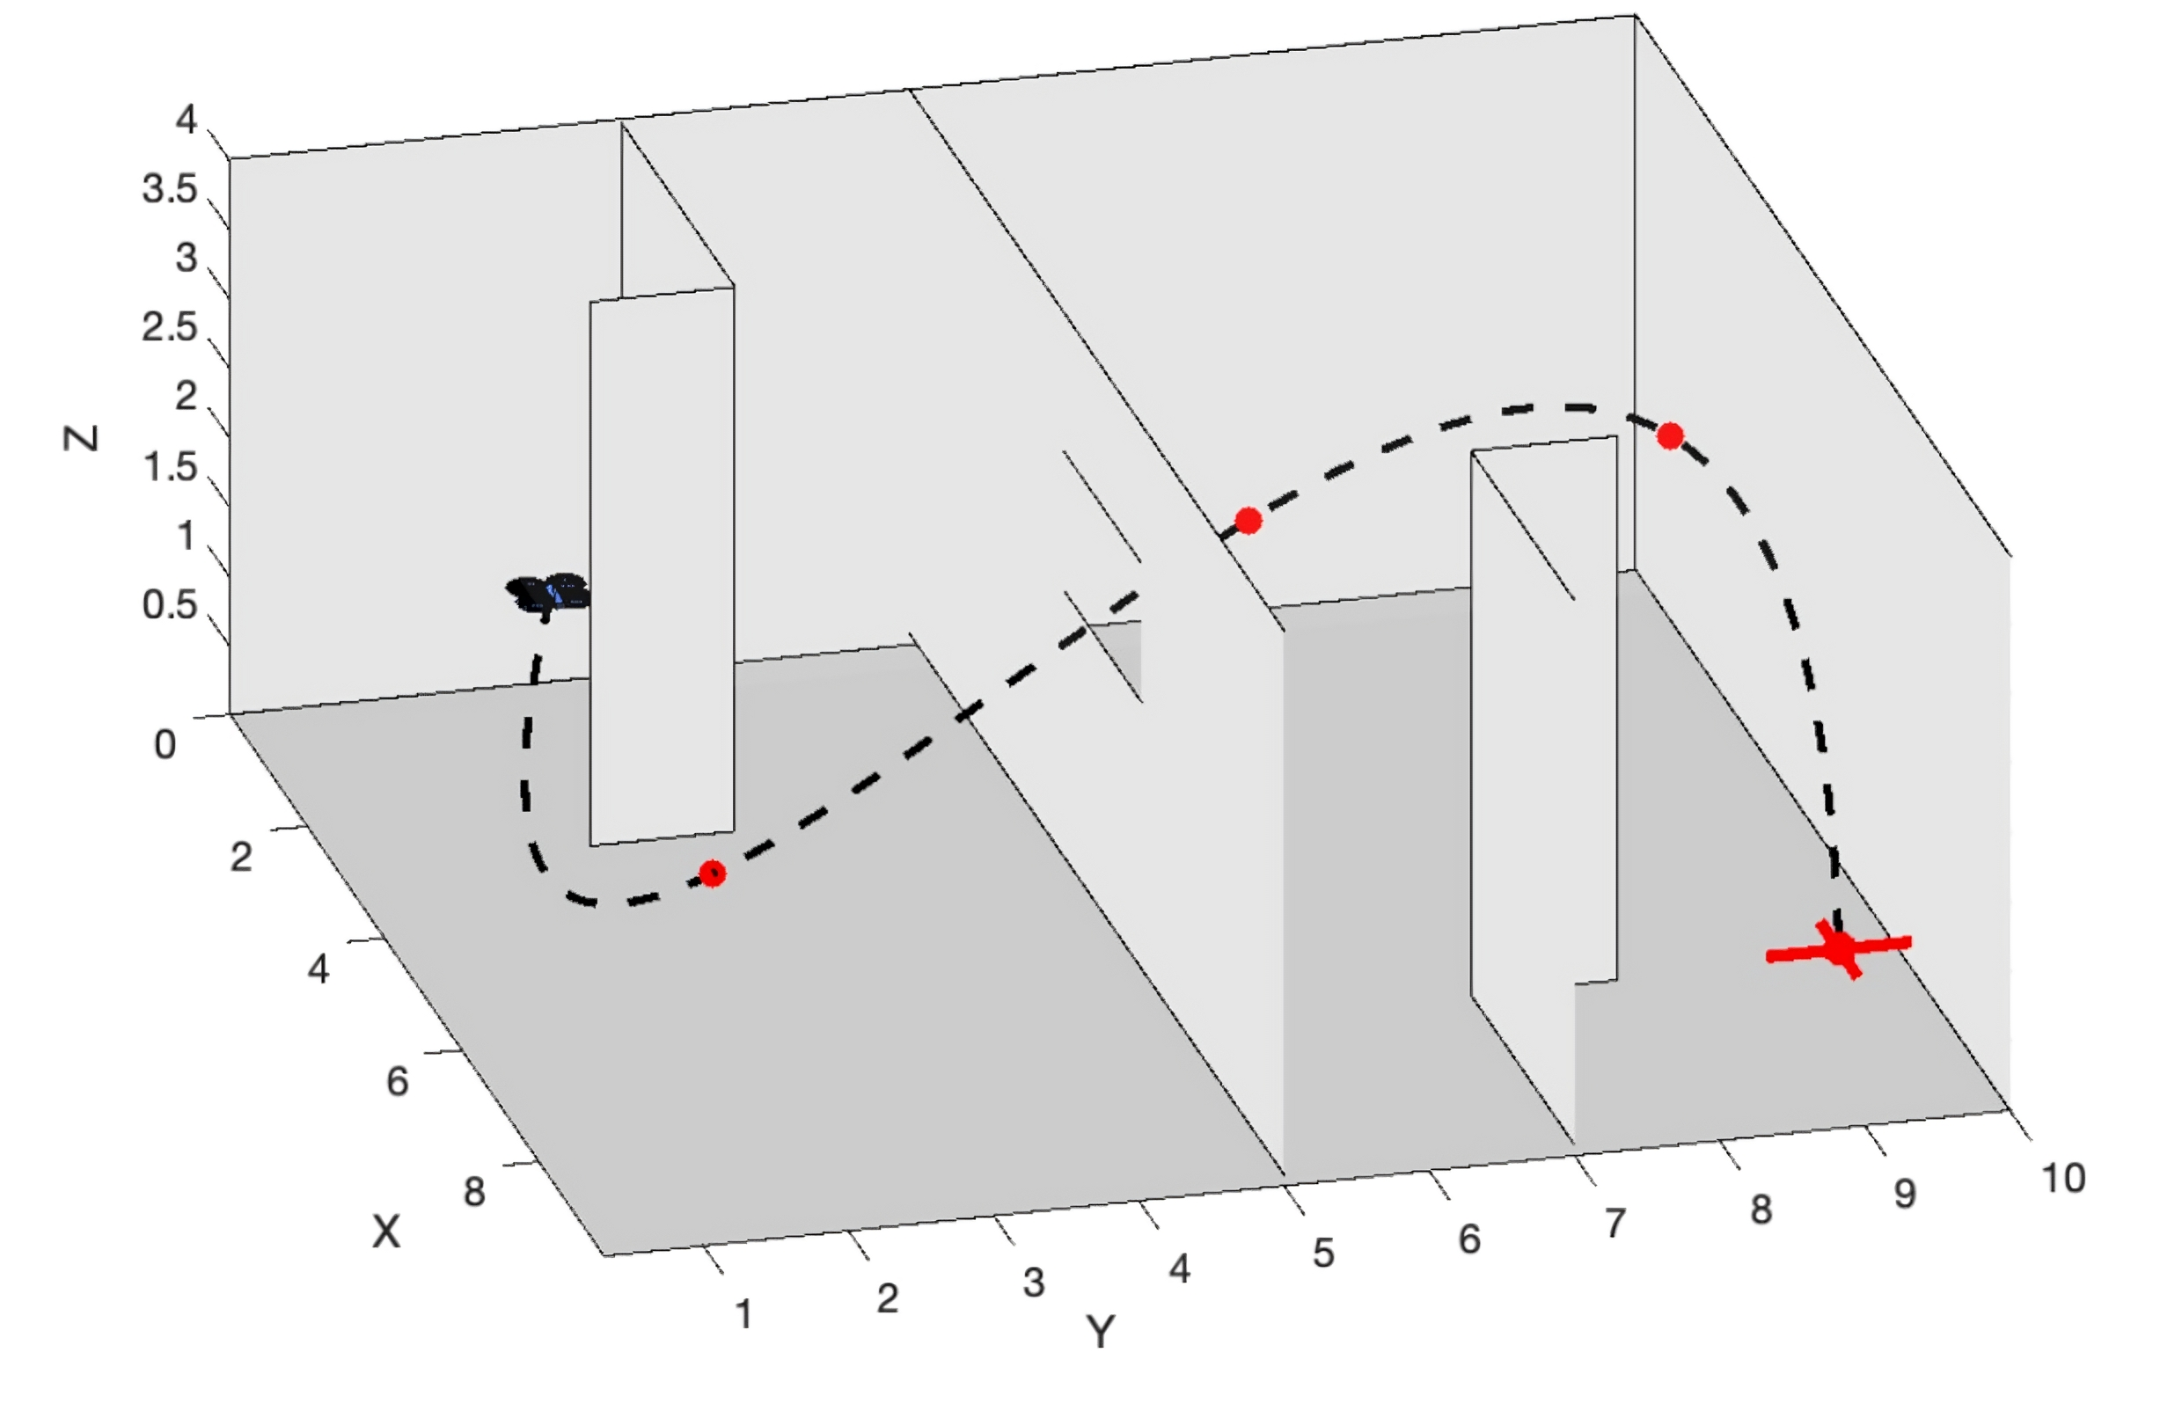
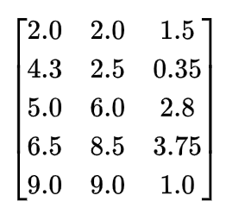
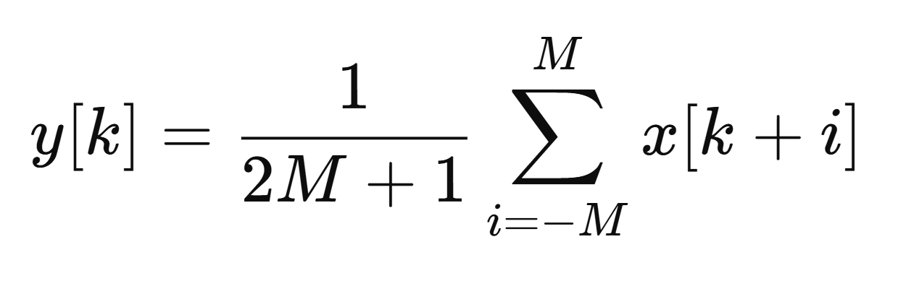
Reference Trajectory Planning
Indoor environment navigation by following a path.
Waypoints based trajectory interpolated using splines.
Moving average filter applied to smooth the trajectory.
Moving average filter
Waypoints matrix

Slide 7
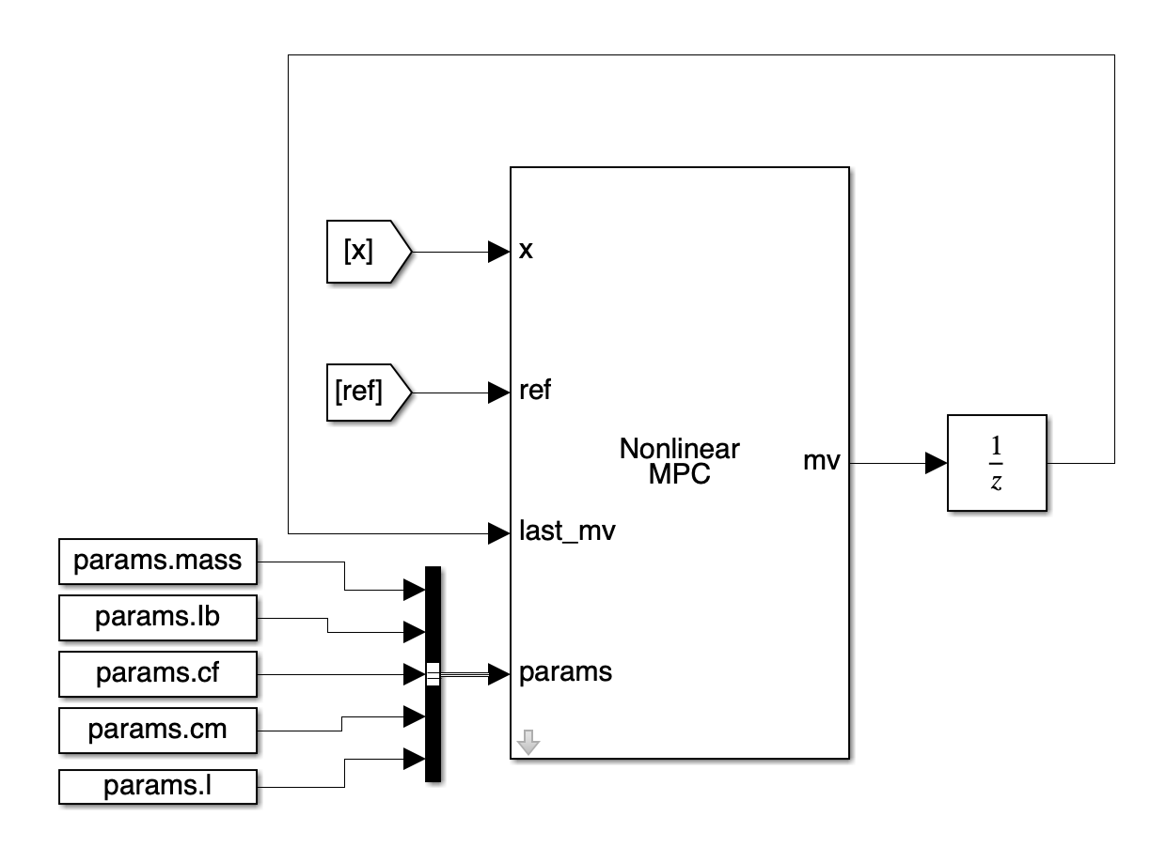
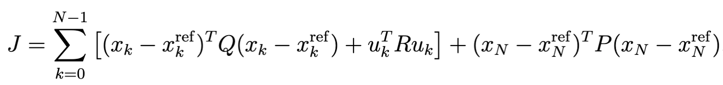
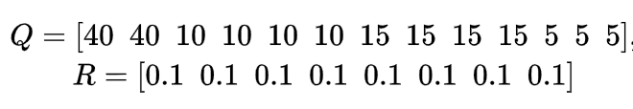
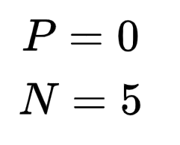
Nonlinear Model Predictive Control (NMPC)
NMPC predicts future behavior over a finite horizon N
Optimization problem is to minimize a cost function while satisfying constraints.

Slide 8
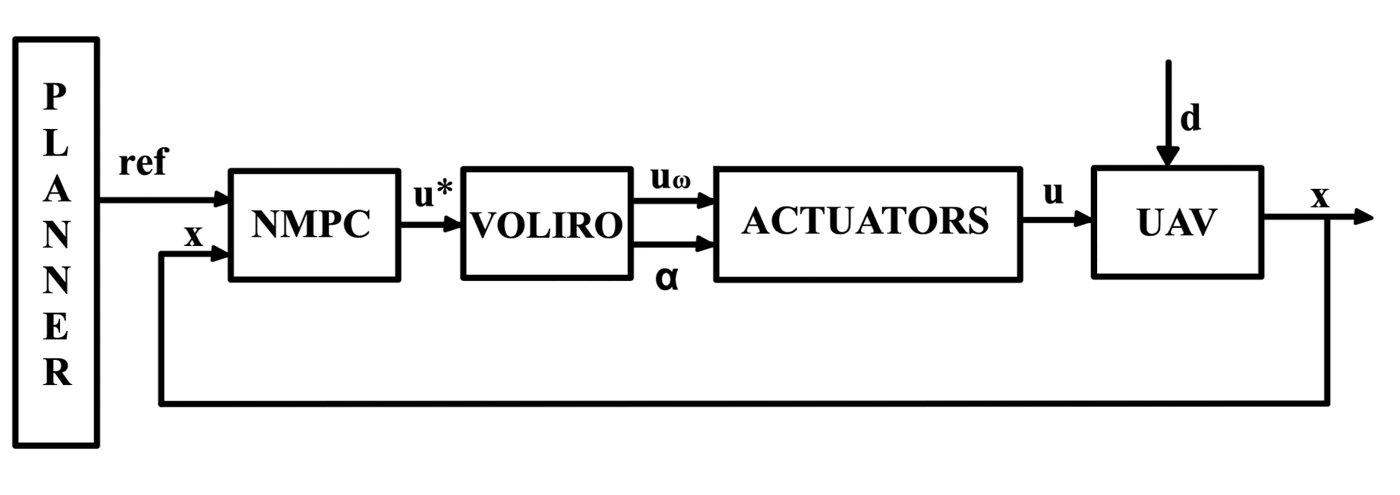
Simulink Implementation
Block scheme of the control logic:

Slide 9
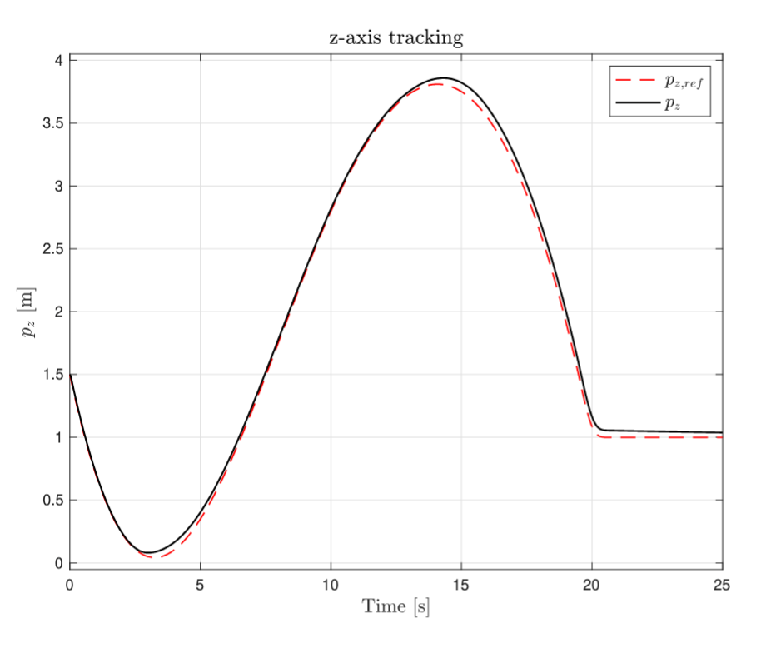
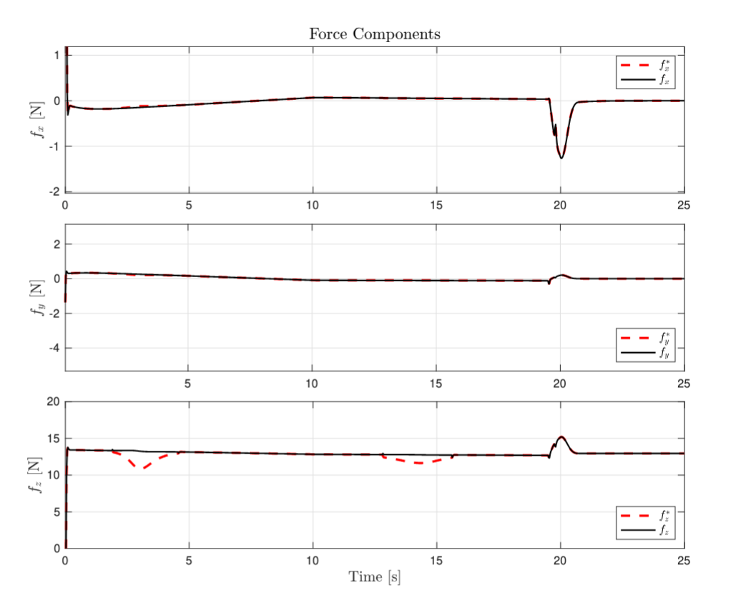
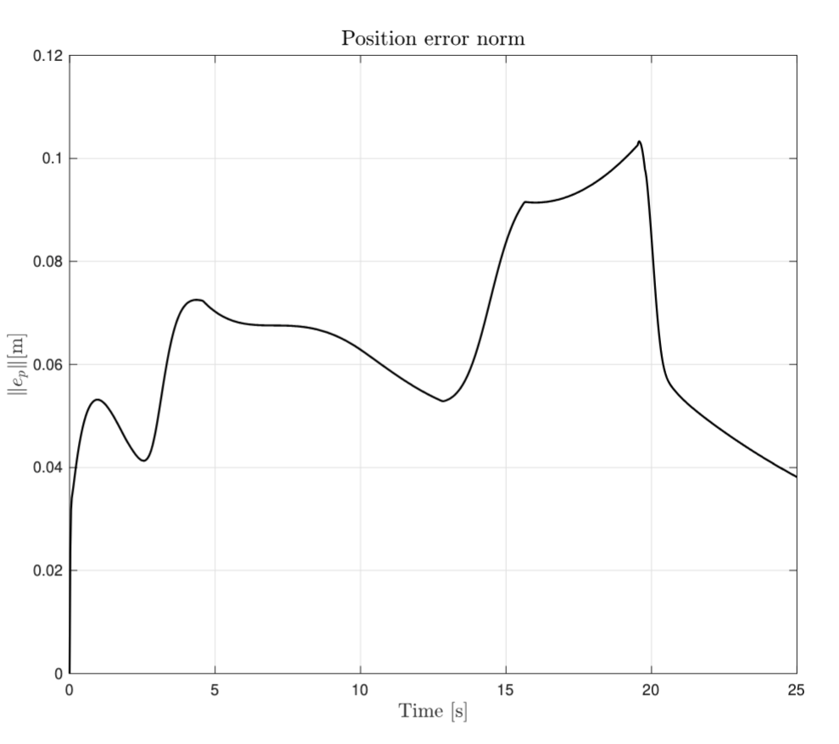
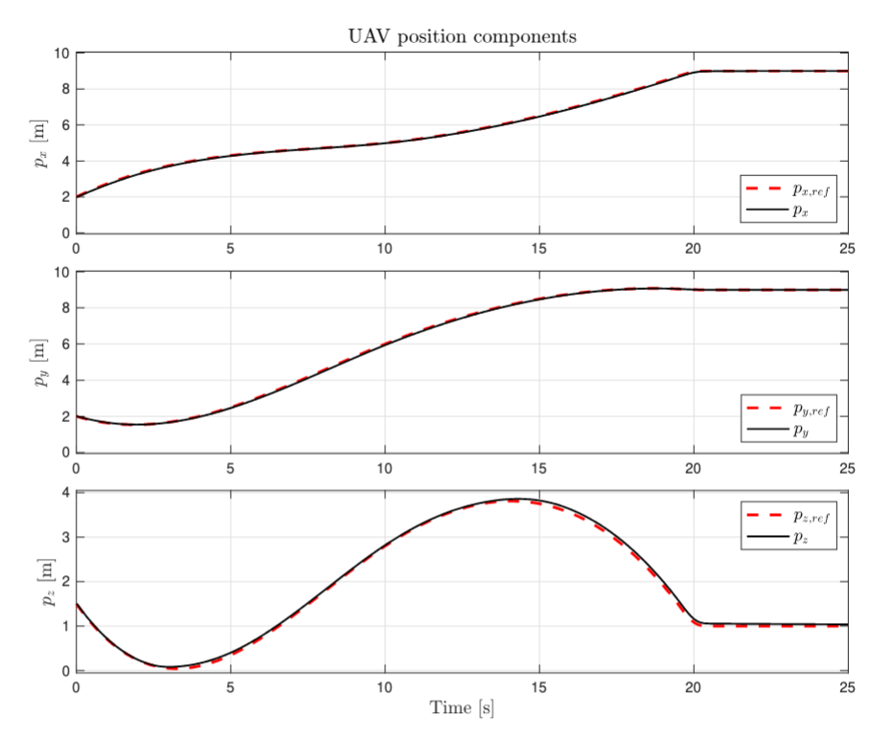
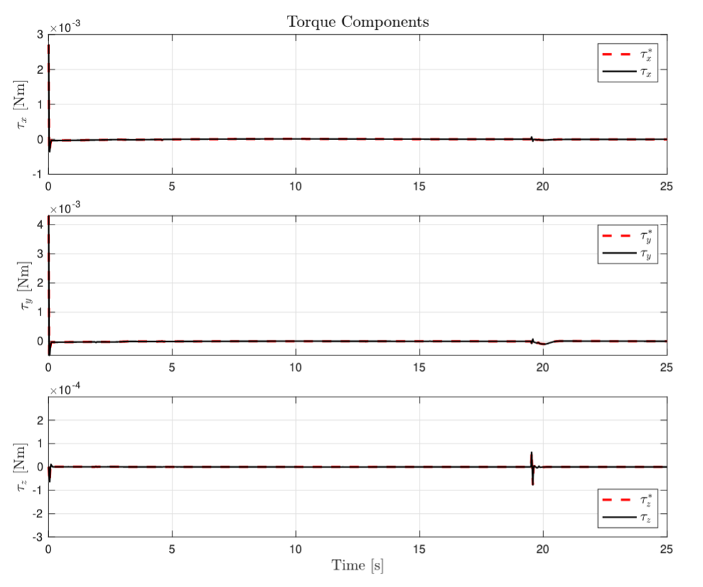
Simulation Results: Default Case
The NMPC controller demonstrates accurate trajectory tracking.

Slide 10
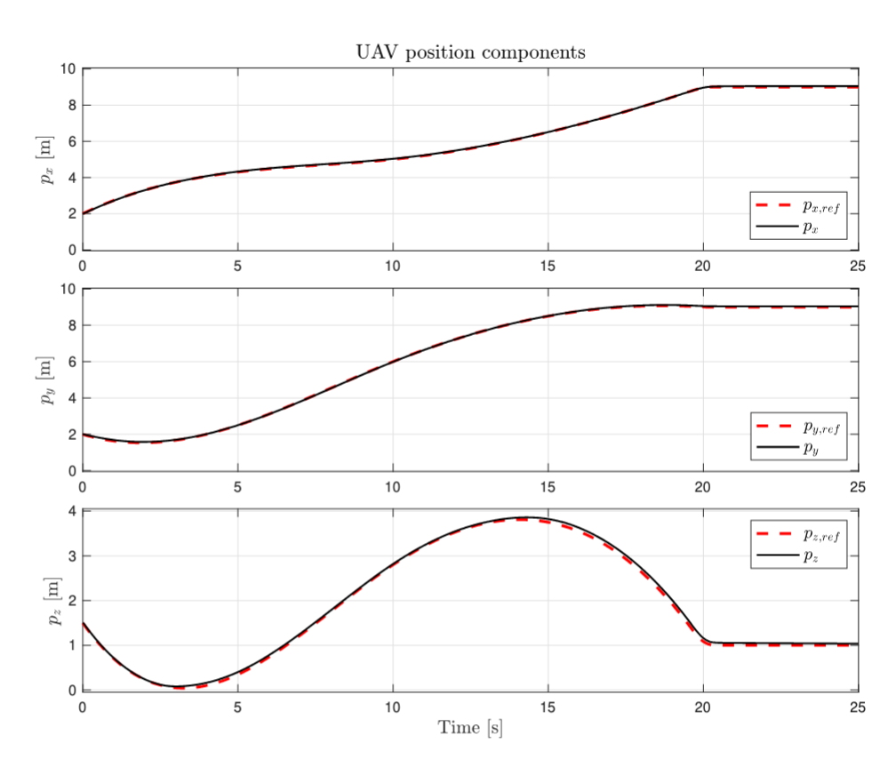
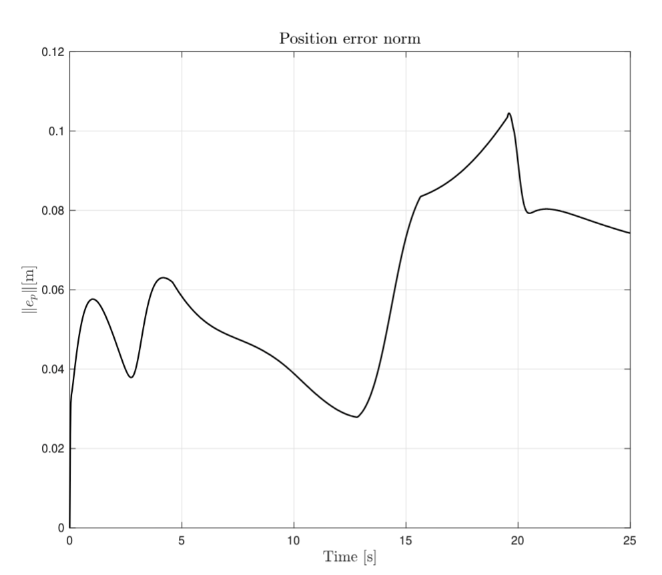
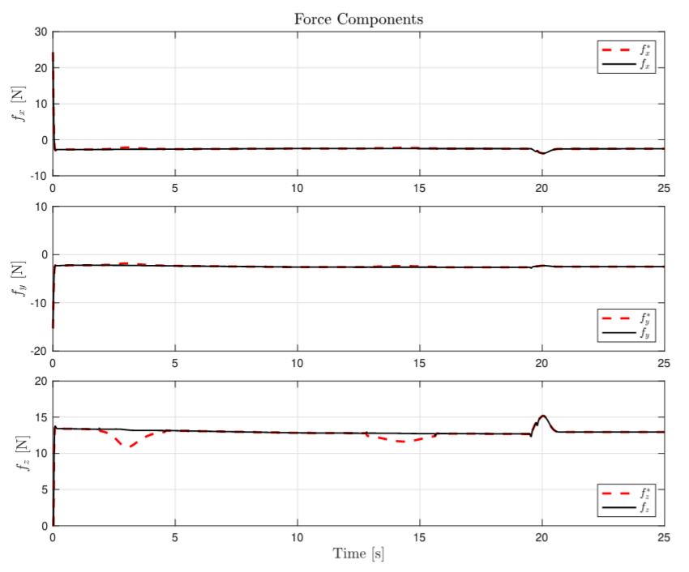
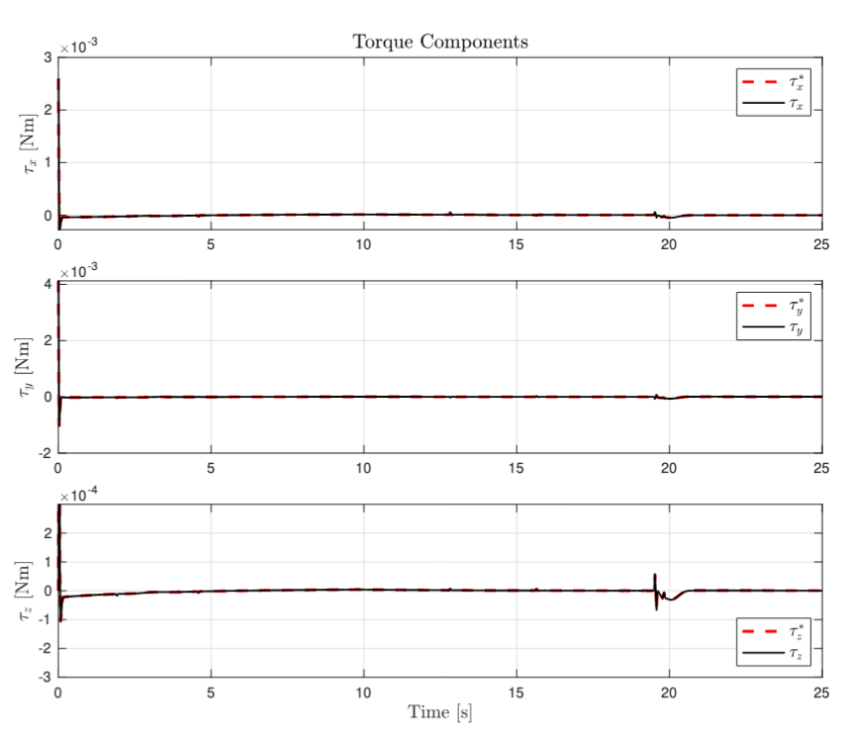
Simulation Results: Disturbed Case
The NMPC controller maintains precise trajectory tracking even in the presence of disturbances.

Slide 11
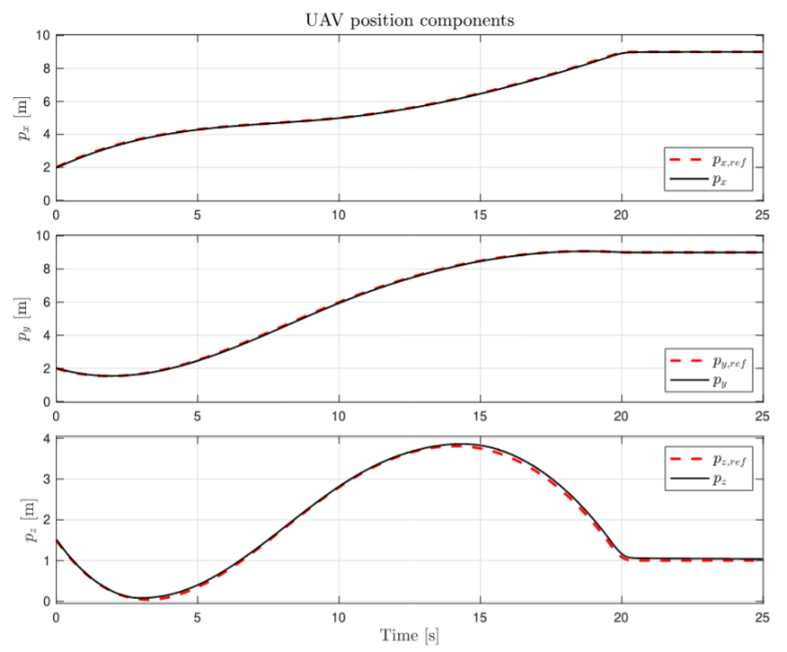
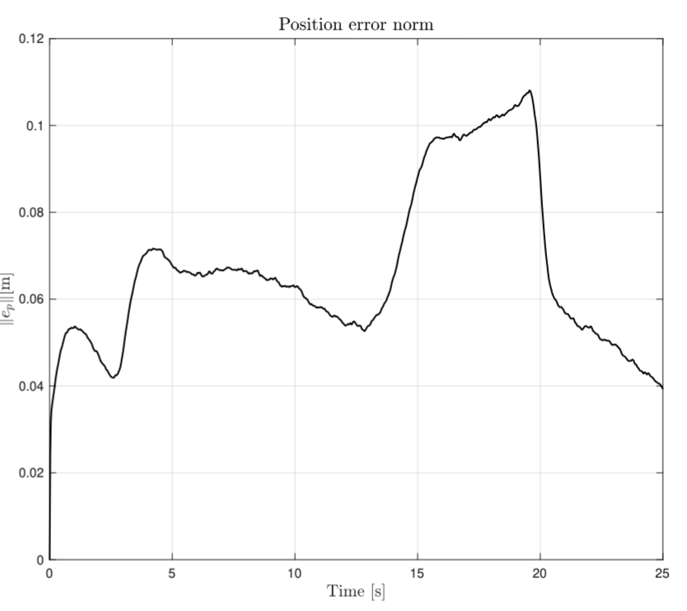
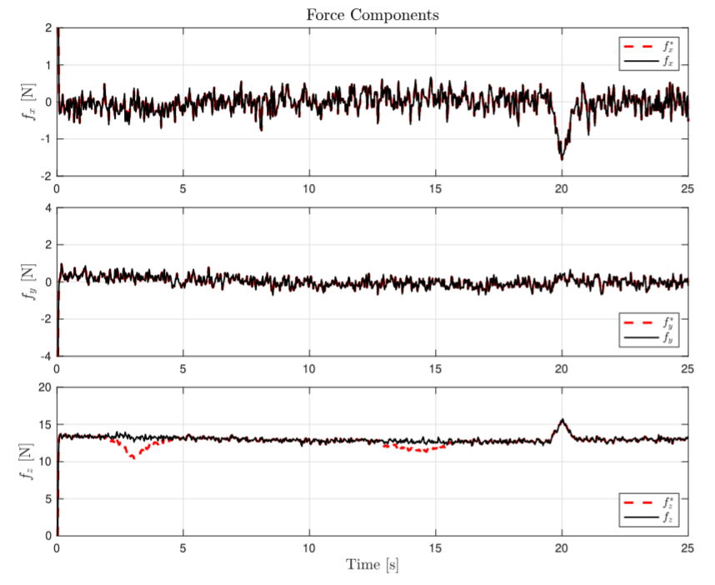
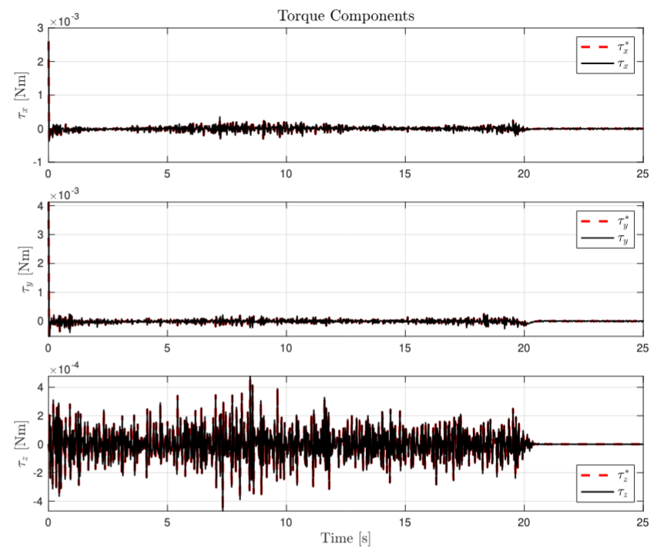
Simulation Results: Disturbed Case
The controller effectively rejects sensor noise without compromising tracking performance.

Slide 12
Simulation Results: Robustness Analysis
The NMPC controller demonstrates accurate trajectory tracking and robustness against various perturbations.
8 cm
9 cm
8 cm
Force profiles adapt to compensate external disturbances and remain stable under noise.
Torques are modulated to ensure attitude stability, with noise introducing noticeable fluctuations.
Default Case
Disturbed Case
Noisy Case

Slide 13
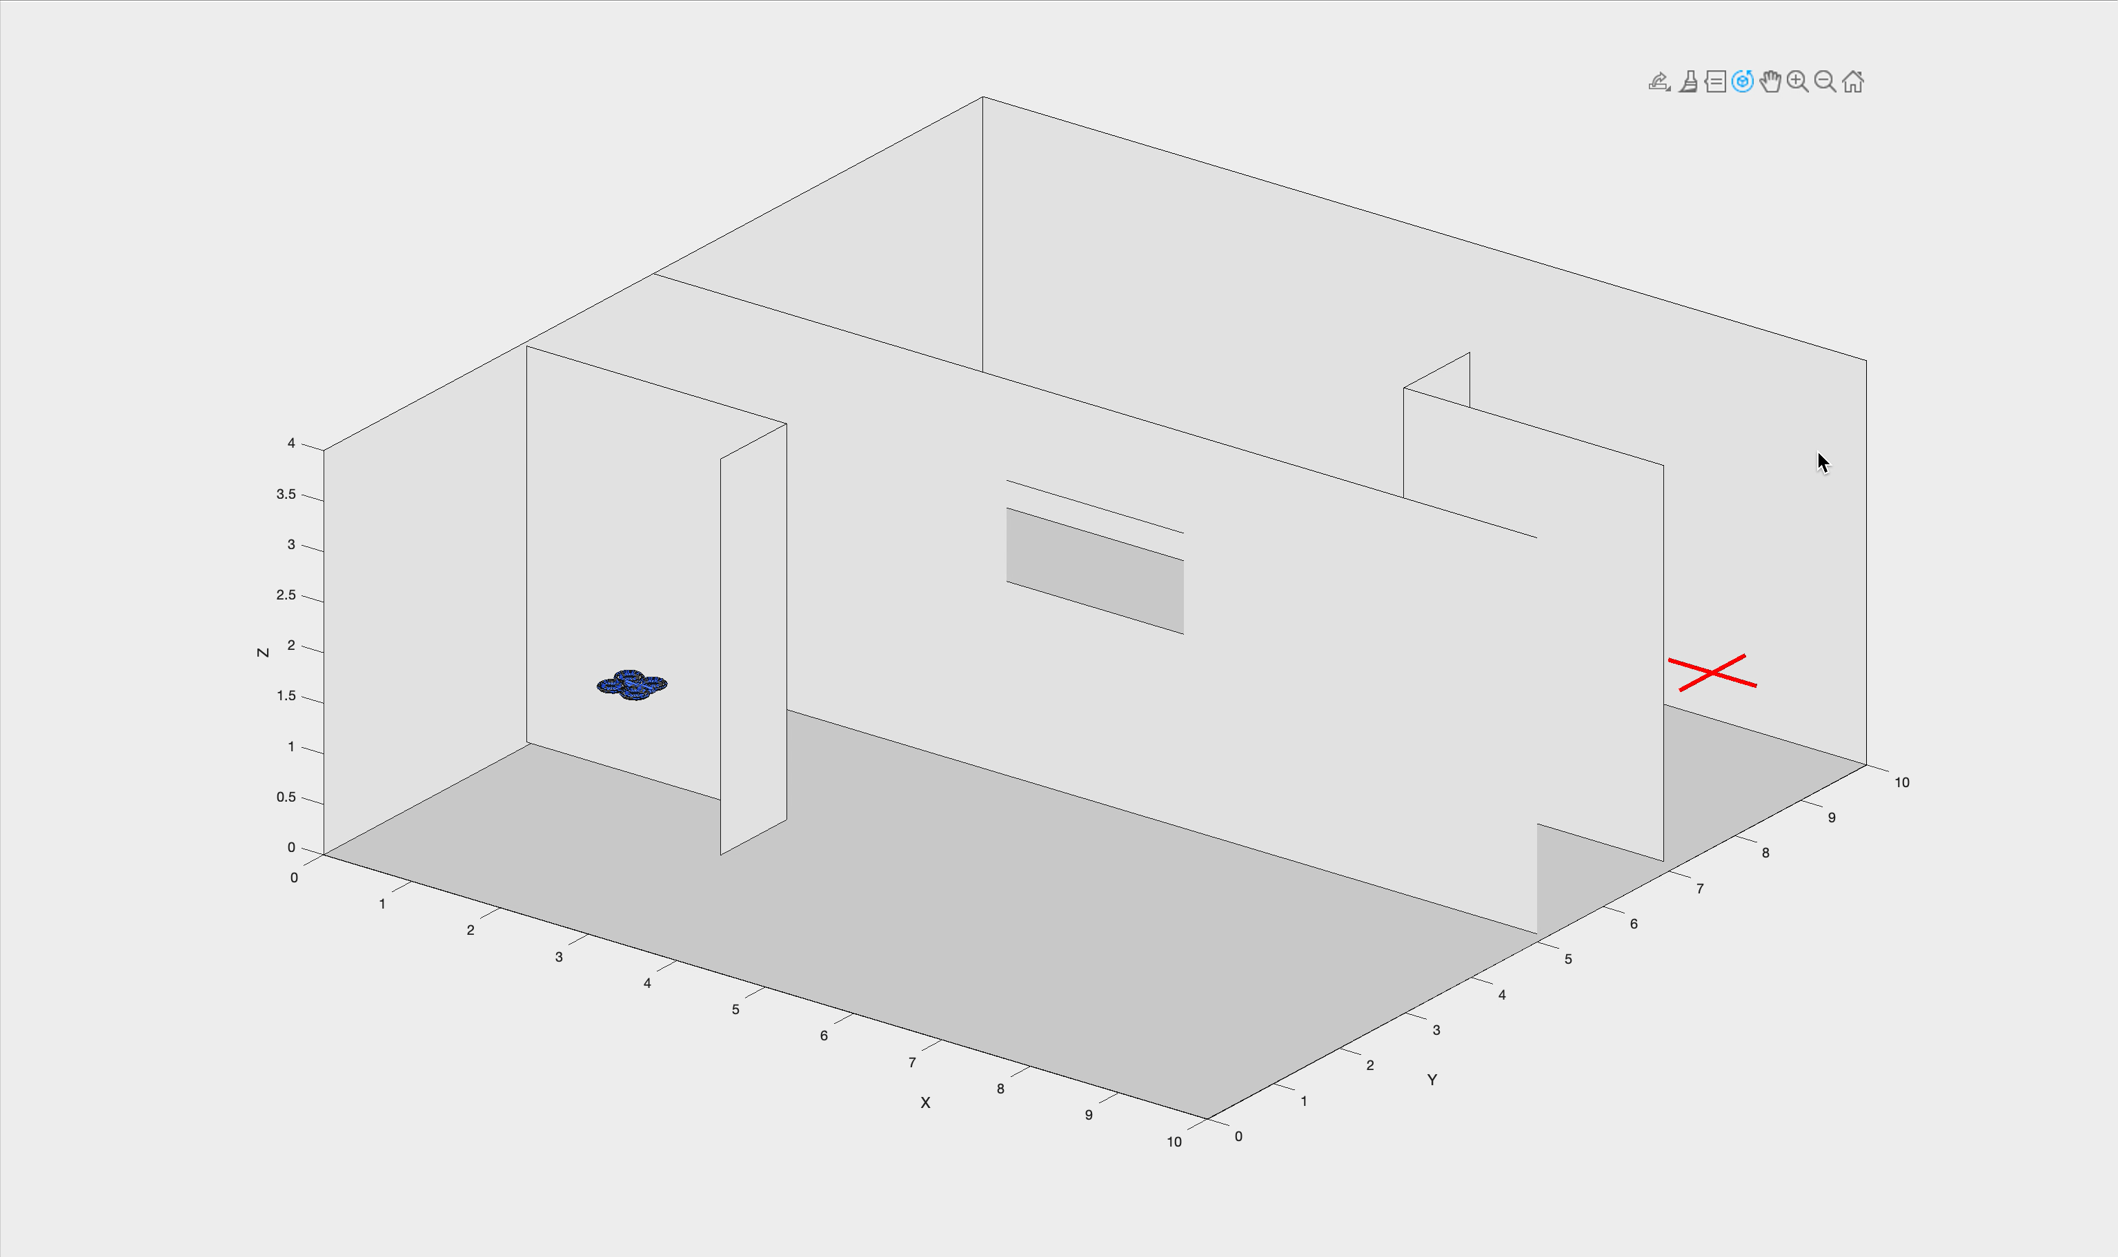
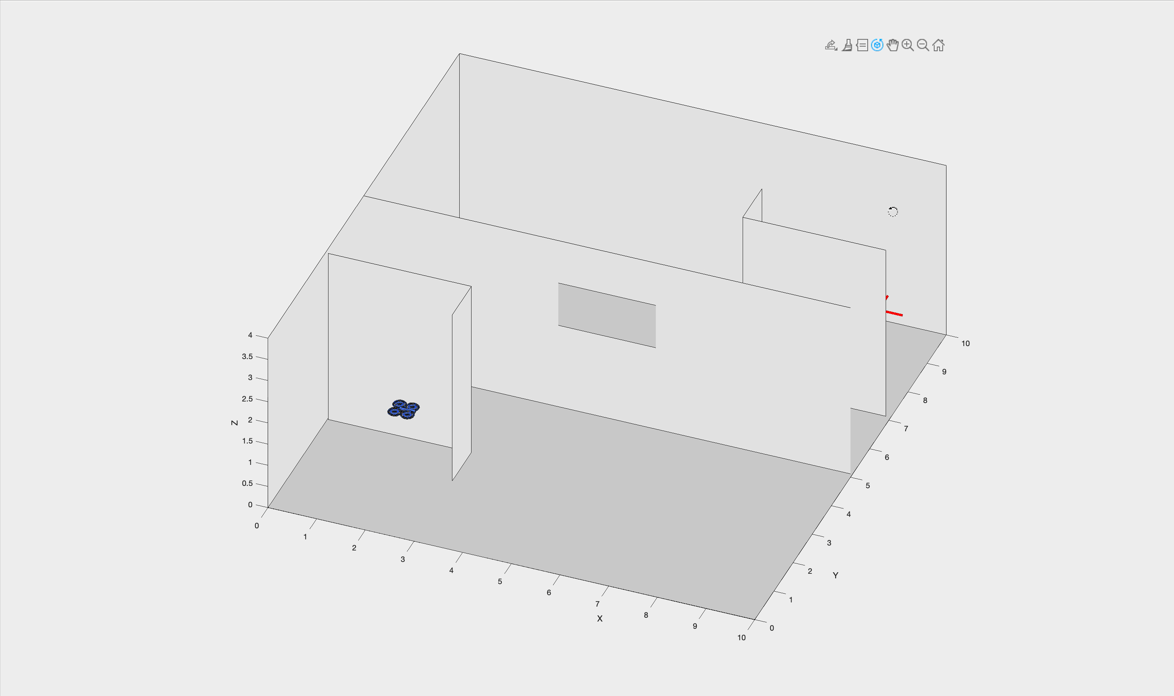
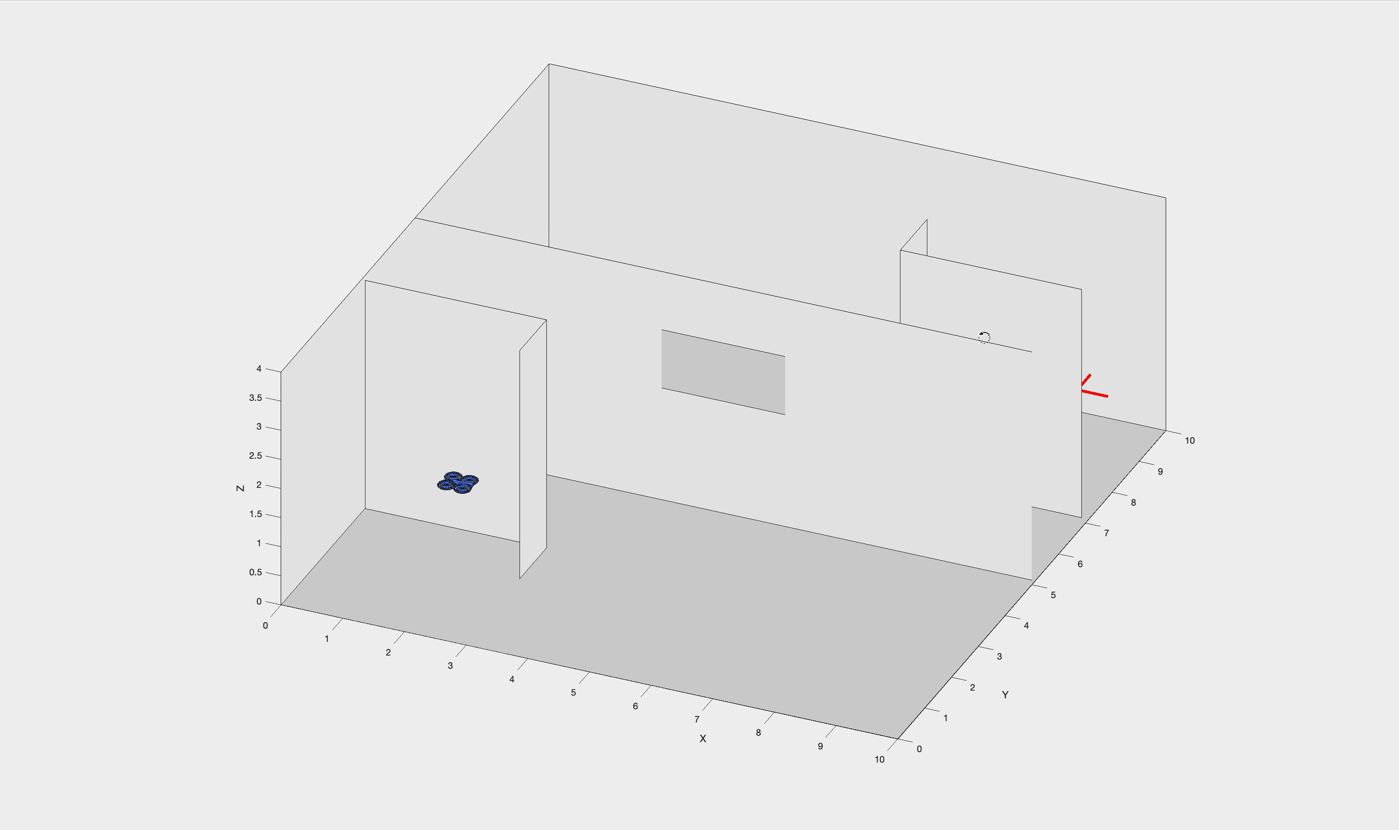
Simulation Results: Robustness analysis
The NMPC controller demonstrates accurate trajectory tracking and robustness against various perturbations.
Default Case
Disturbed Case
Noisy Case

Slide 14



Conclusions & Future Developments
The NMPC controller effectively minimizes errors and rejects disturbances, demonstrating strong prediction capabilities.
Optimal State Observers
Adaptive Elements
Integrate Kalman filters to reduce steady-state errors.
Improve performance in complex environments.
Obstacle Avoidance
Battery Handler
Implement advanced collision prevention.
Develop for real hardware implementation.

Slide 15
Thank you for your attention!

